Slide 1
EVALUATION OF USABILITY OF WornOnTV.net
Ünal Ramazan DOĞANGÜN

Slide 2



EDMS Heurıstıc walkthrough
1 USER ROLE
10 EDMS PAGES
5 HOURS

Slide 3
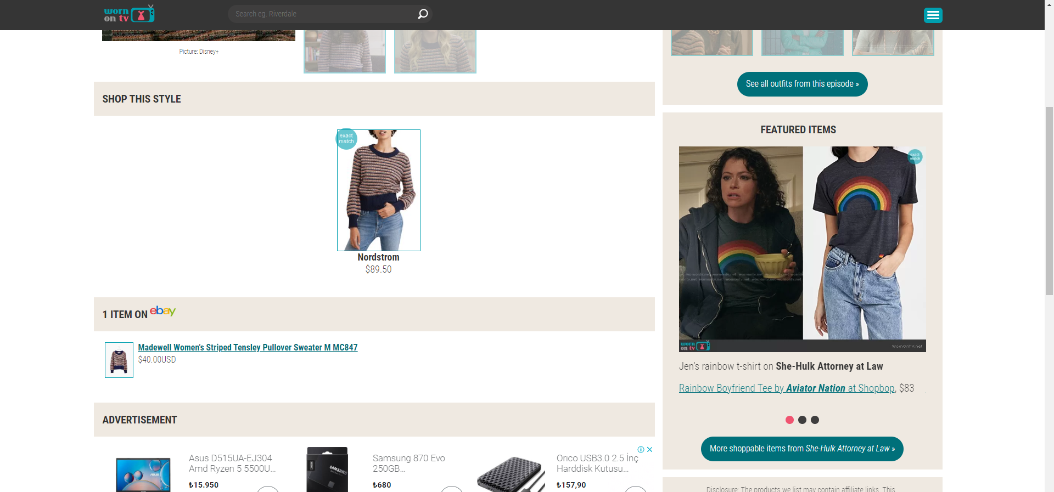
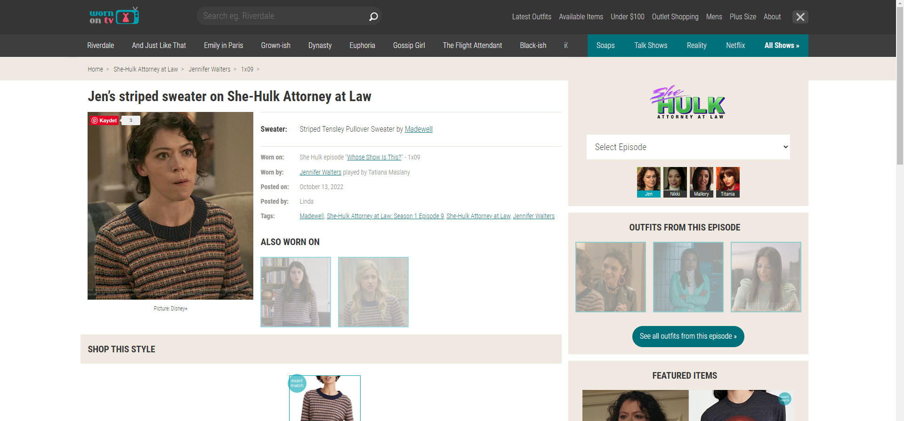



We can only click the radio buttons at the bottom to switch between the products in the side menu showing the clothes entered by the actors playing in the same program. There is no other transition method. When switching between products, the user is forced to use only one method. Instead, buttons can be added to the sides of the products, or the user can switch between the products with mouse's joystick.
The website does not allow users to zoom in on clothes. This prevents users from taking a closer look at clothing images.
To fix this, pictures can be zoomed in or appear larger in the middle of the screen when the cursor moves over the pictures.

Slide 4
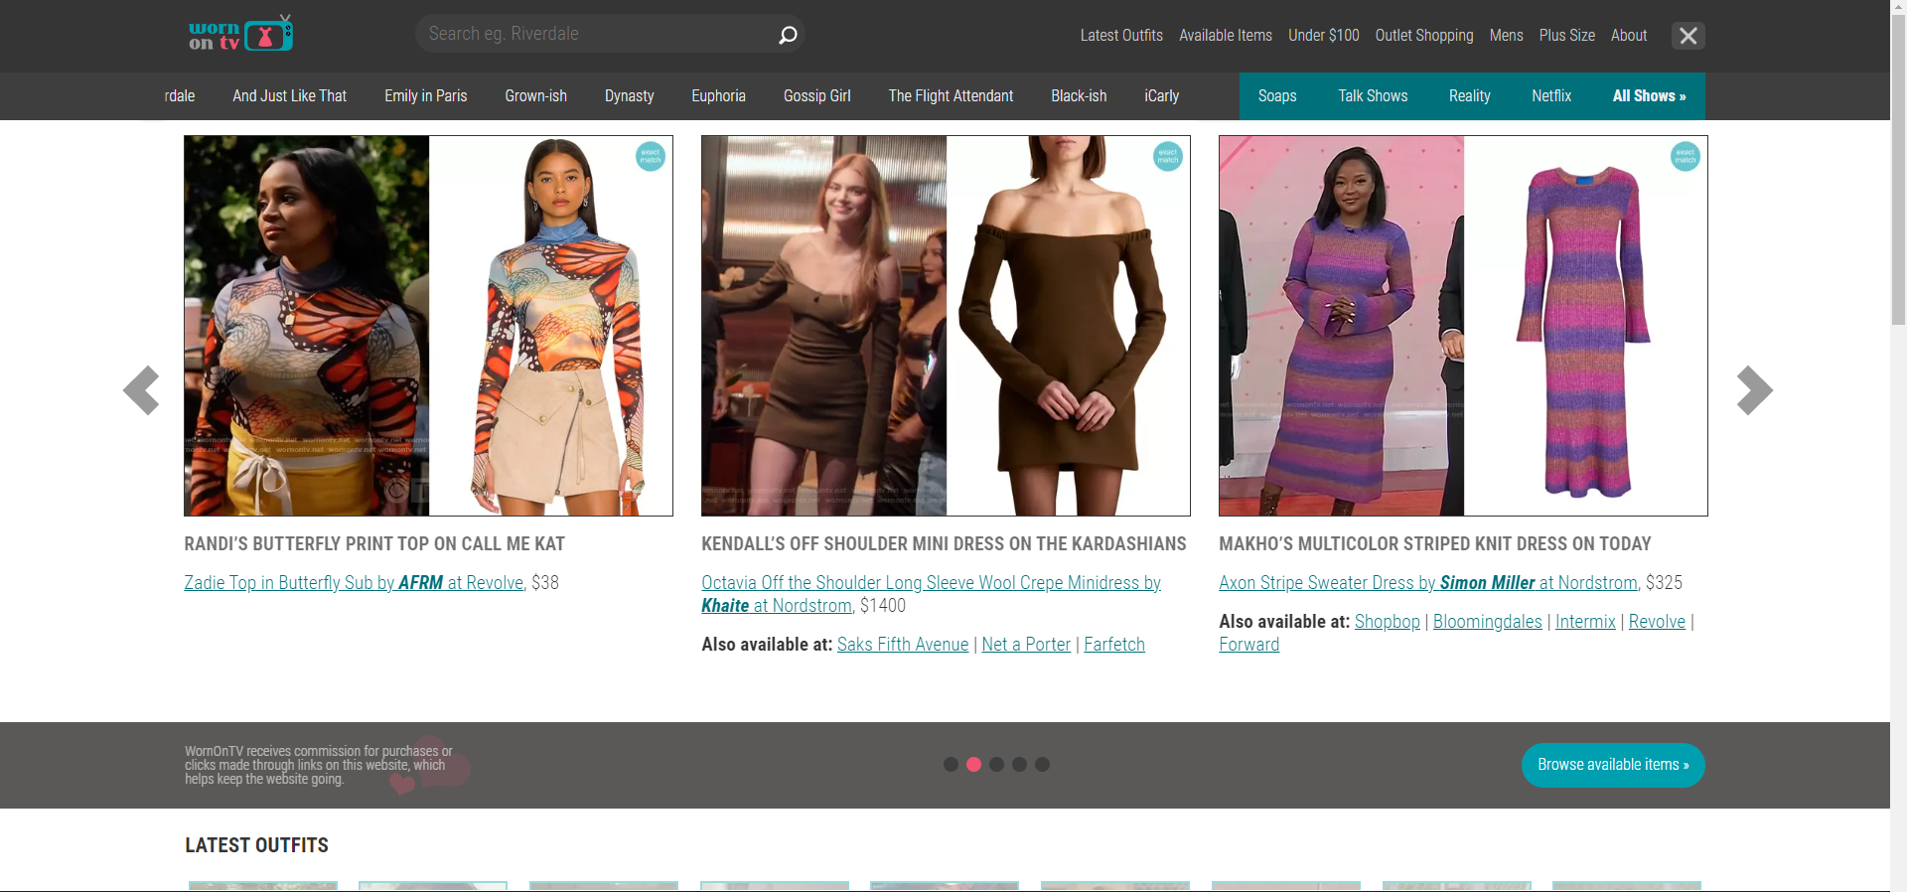
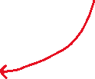
The designs and texts of the popular clothing images shown on the homepage are not compatible with each other. This place can be made more user friendly.

Slide 5
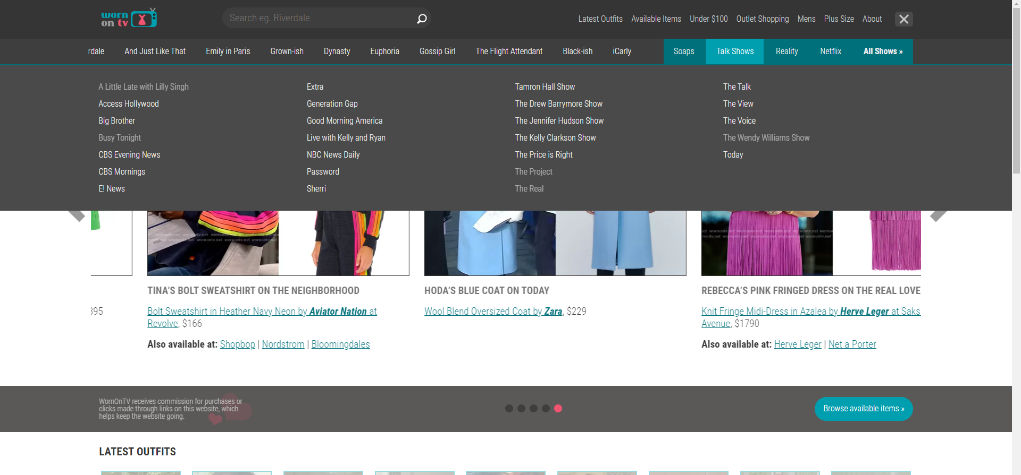
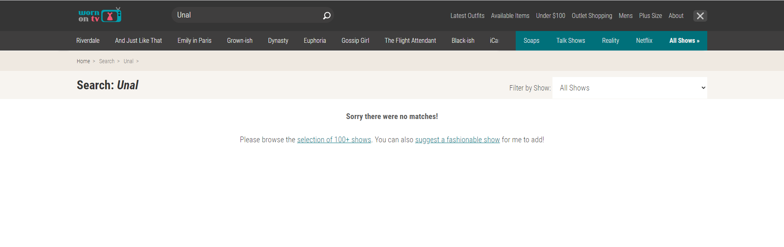


Some of the colored buttons on the homepage work when you click, some do not. The colors of the buttons that do not open a new page when clicked can be changed.
When I'm looking for something that's not in the system, it allows me to make a call. And it opens another page to warn me, instead of saying that it couldn't find anything like that right there.

Slide 6
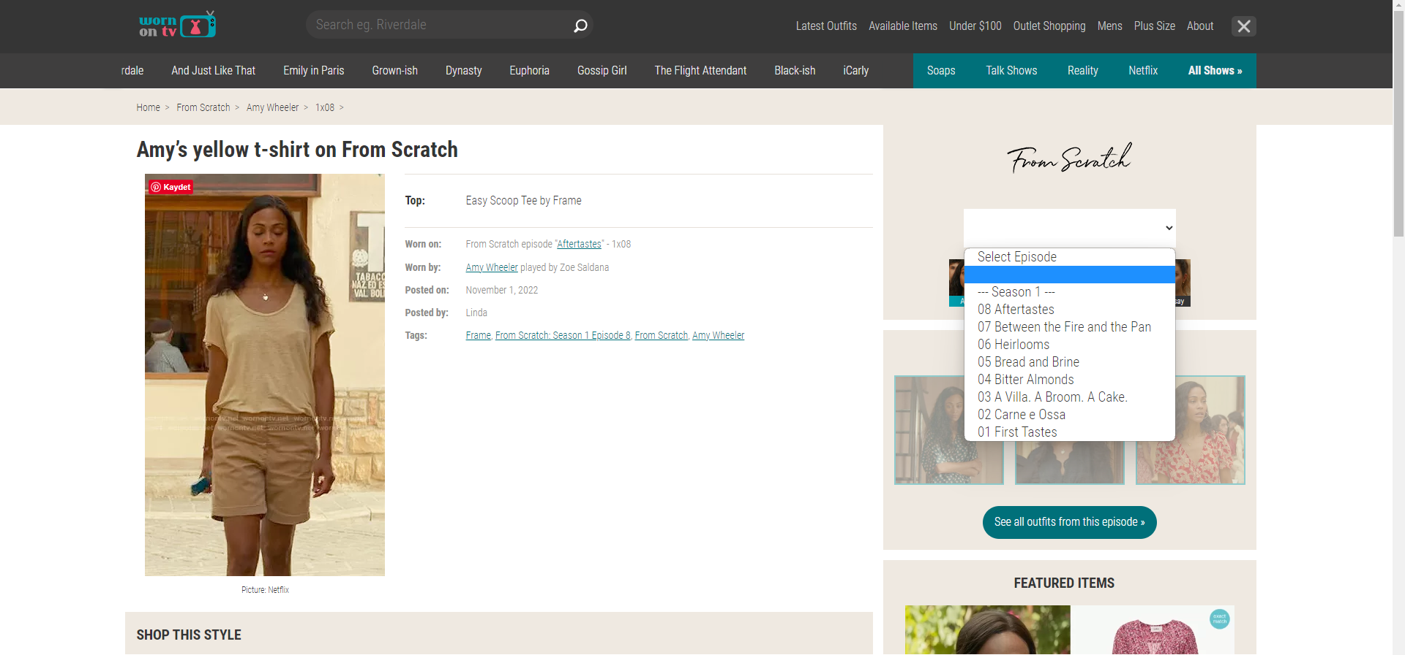

It does not prevent me from clicking on a place that is not in the list and the name of the season in the side menu showing the episodes in the program.

Slide 7
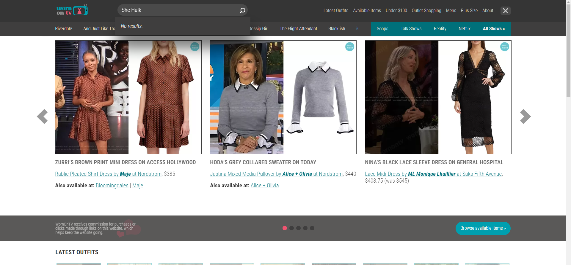


I have to click at least 3-4 times to get to a dress I want to buy. Instead, when I type what I want in the search section, there might be a section that offers clothes.

Slide 8
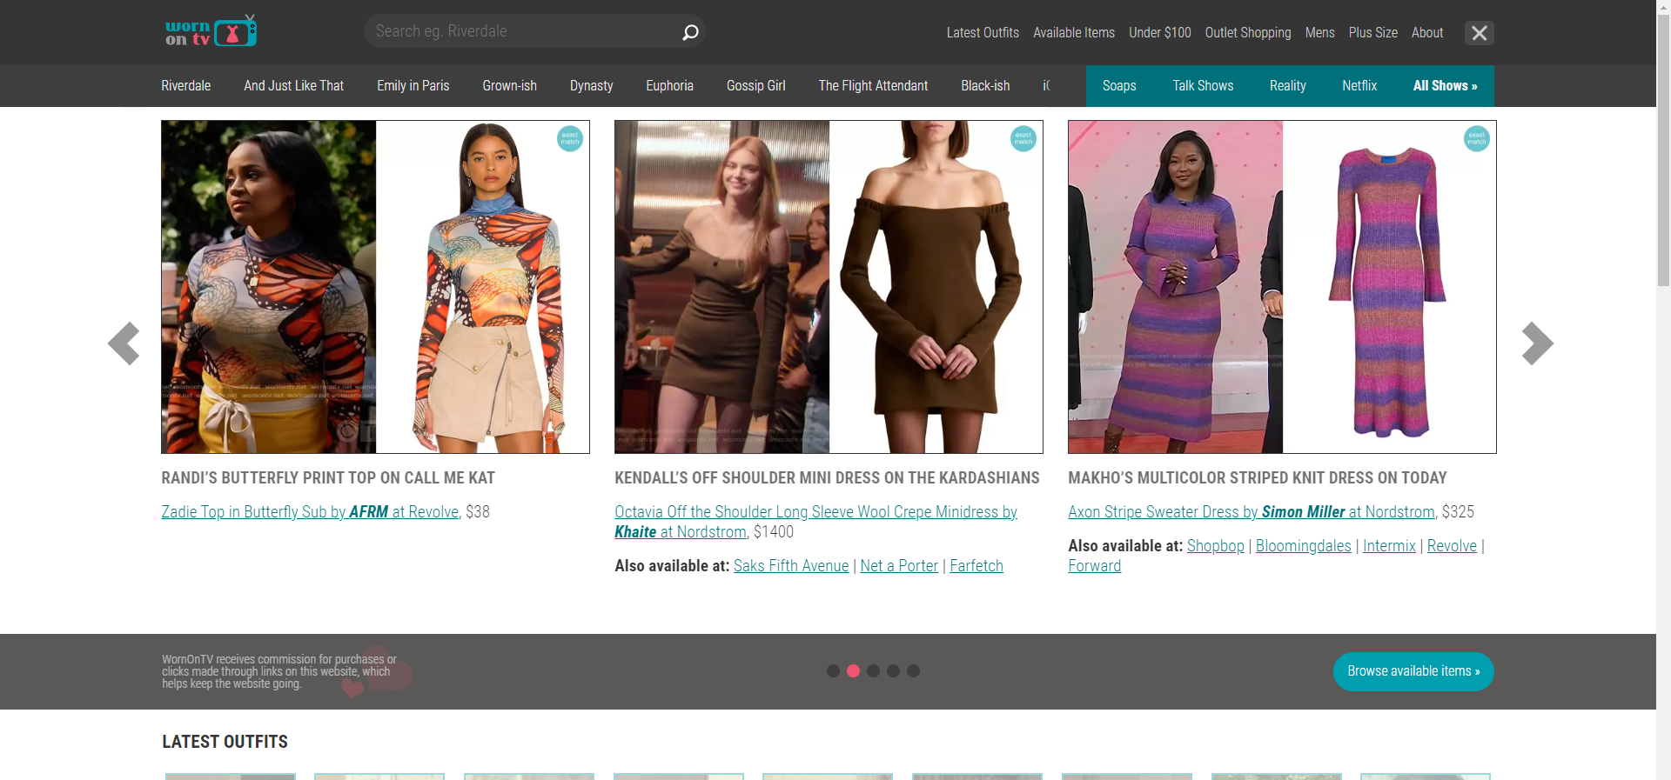
The design of the homepage is not user friendly. Color selection and designs are poorly done. A more colorful and simple design can be made. User trends can be viewed.

Slide 9

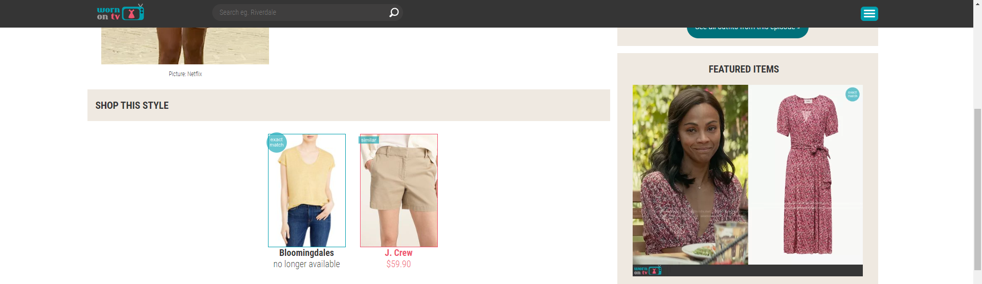

I can't see items that I've already looked at or researched. When I clicked on the search section, the words I had written before should appear. It could appear in a section on the main page in the products I looked at before.
A different color tone may appear on the products I click. Thus, the user can see the products the user is looking at.

Slide 10
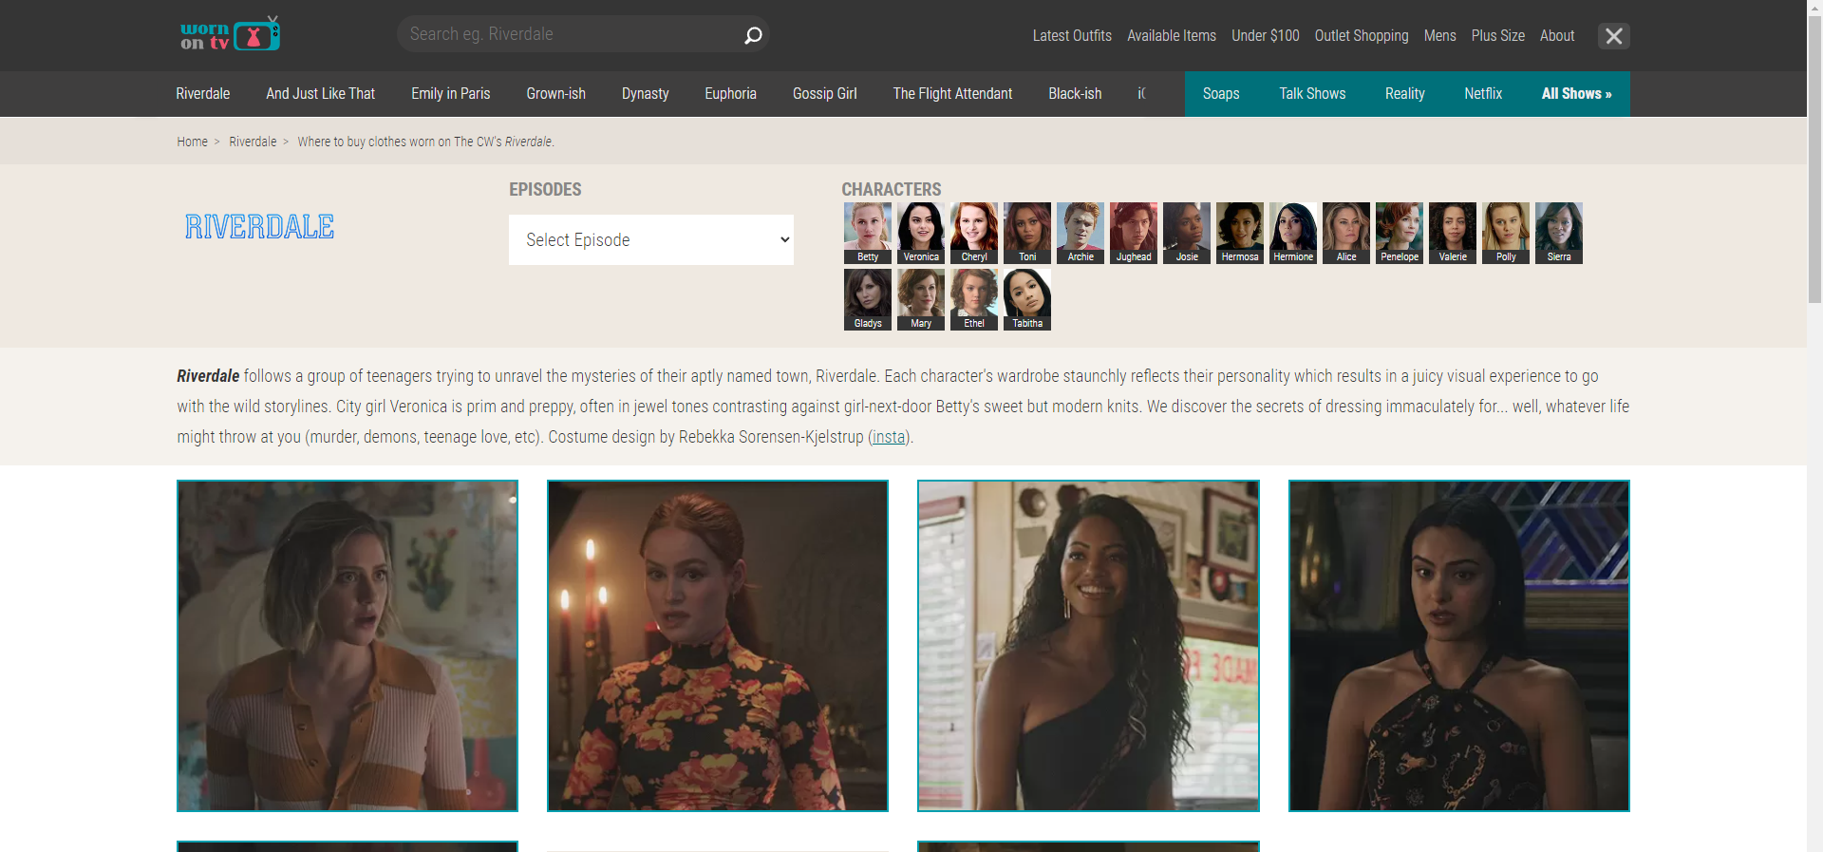
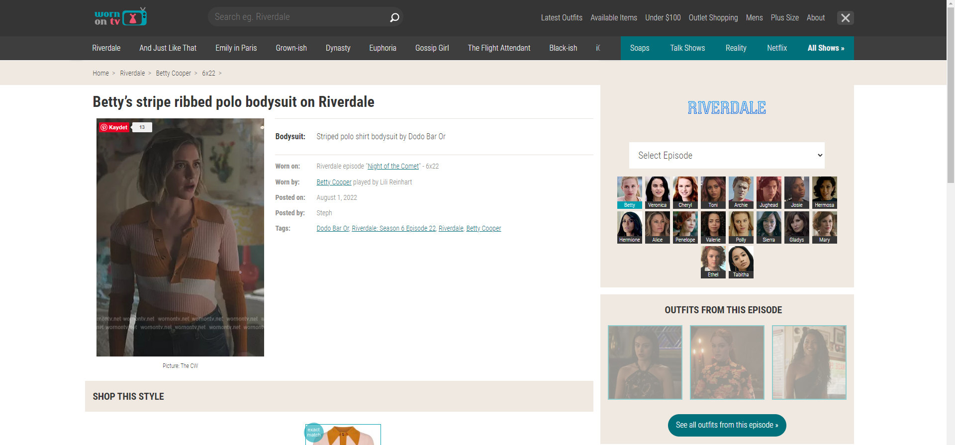

When we look at the detailed information about the program, the button showing the players and the names of the players is made very small. They need to be enlarged in size.
The visuals and names inside the buttons showing the actors who played in the same program with the actor are made very small. They need to be enlarged in size.

Slide 11
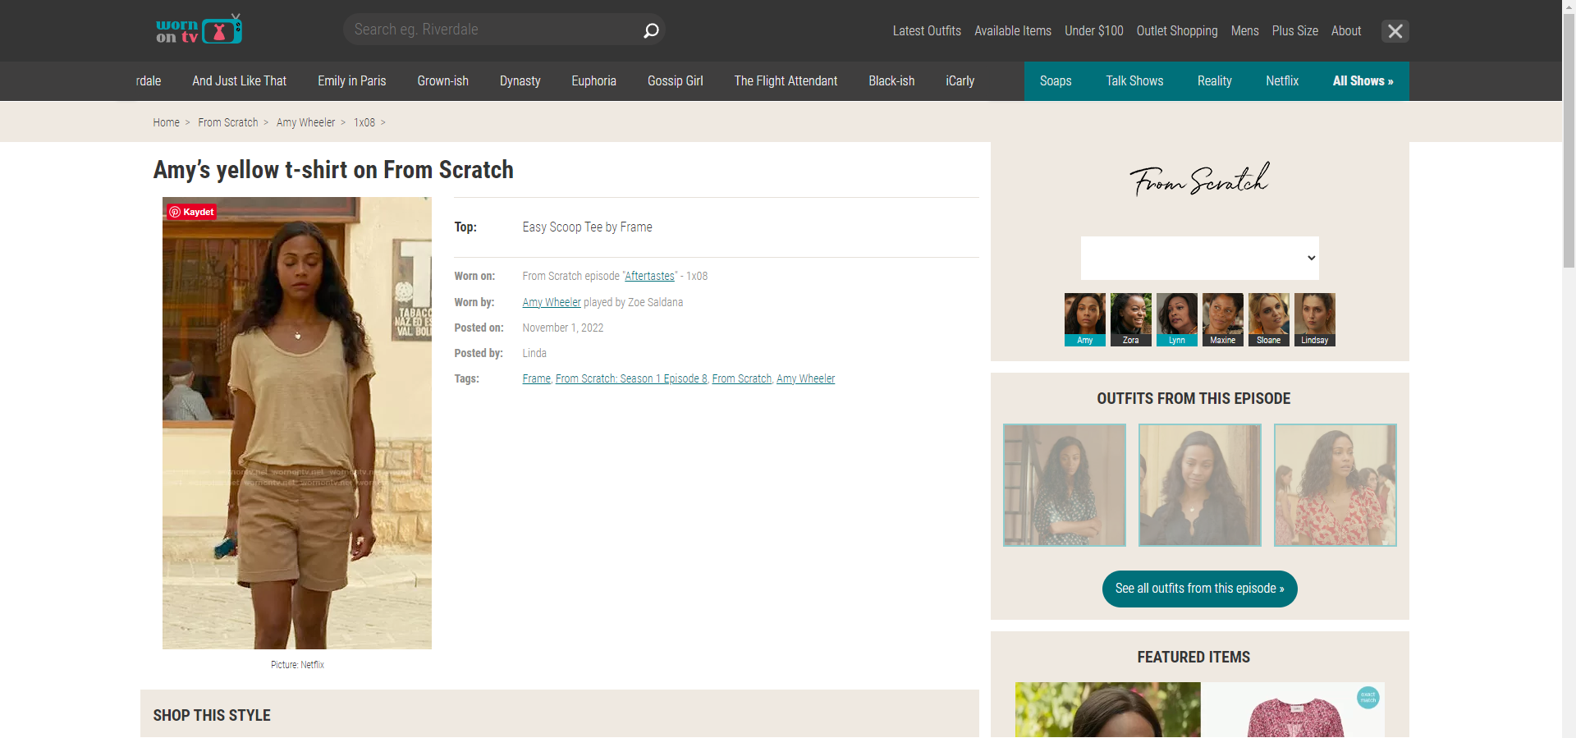

Where we get more detailed information about the clothes of the actors, the color change of the buttons used to switch to other actors has the same color as selected the actor.

Slide 12
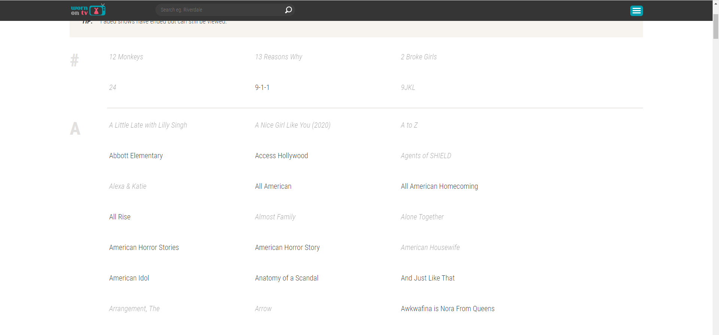

In the section where all programs are shown, the names of some programs are used as if they were not active. But it works when clicked. All active links here can be made the same color.
Active Links

Slide 13
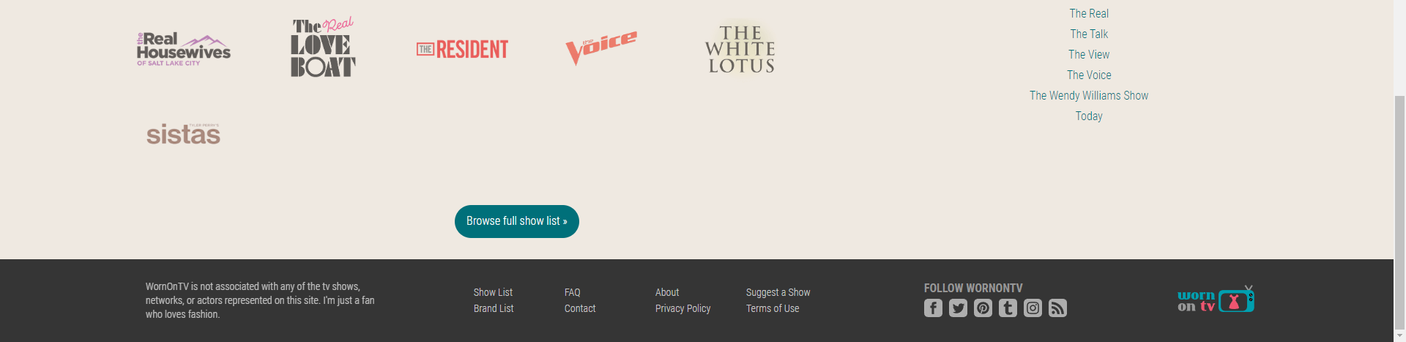

The button I marked on the side seems to be related to the internet settings at first. But when clicked, the codes of the site appear.

Slide 14
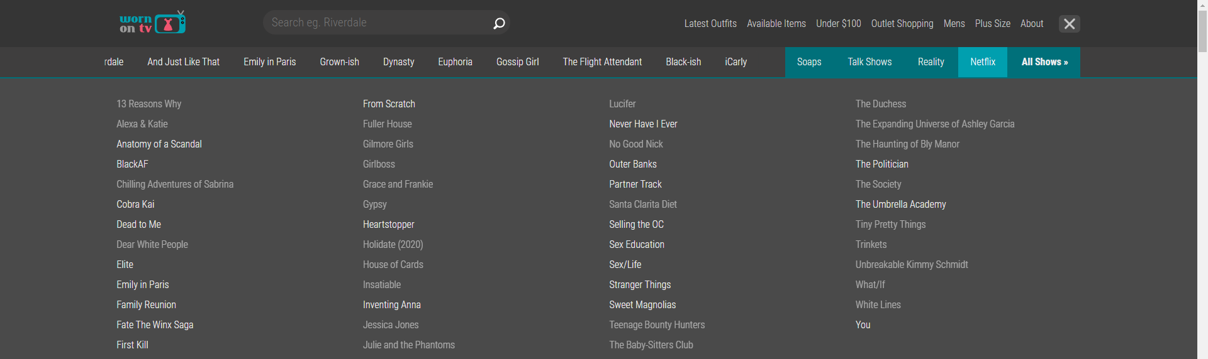

All streaming platforms( like HBO Max, Disney+, Amazon Prime, etc) currently on the market need to be added. In this way, the user can find what he is looking for faster.

Slide 15
Thank You
Ünal Ramazan DOĞANGÜN

